Slide 1




Employee Turnover HR Data
Analysis using Python

Slide 2

Project Employee Turnover HR Data Analysis using Python
Submitted by:
KISHOR SARKAR
SUVADIP MANDAL
JOYDIP SARKAR
SAMIUL AZIZ
SANJIB MALLICK
Mentor:
Tania Chakraborty

Slide 3

Slide 3
Introduction
An Introduction with the Industry: HR analytics enables HR professionals to make data-driven decisions to attract, manage, and retain employees, which improves ROI. It helps leaders make decisions to create better work environments and maximize employee productivity

Slide 4

Employee Turnover
Employee turnover refers to the number or percentage of workers who leave an organization and are replaced by new employees. Measuring employee turnover can be helpful to employers that want to examine reasons for turnover or estimate the cost-to-hire for budget purposes.
Notes:
When conducting research, it is easy to go to one source: Wikipedia. However, you need to include a variety of sources in your research. Consider the following sources:
Who can I interview to get more information on the topic?
Is the topic current and will it be relevant to my audience?
What articles, blogs, and magazines may have something related to my topic?
Is there a YouTube video on the topic? If so, what is it about?
What images can I find related to the topic?

Slide 5


Notes:
Once you find your sources, you will want to evaluate your sources using the following questions:
Author:
Who is the author?
Why should I believe what he or she has to say on the topic?
Is the author seen as an expert on the topic? How do you know?
Current:
How current is the information in the source?
When was the source published?
Is the information out-of-date?
Accuracy:
Is the content accurate?
Is the information presented objectively? Do they share the pros and cons?

Slide 6
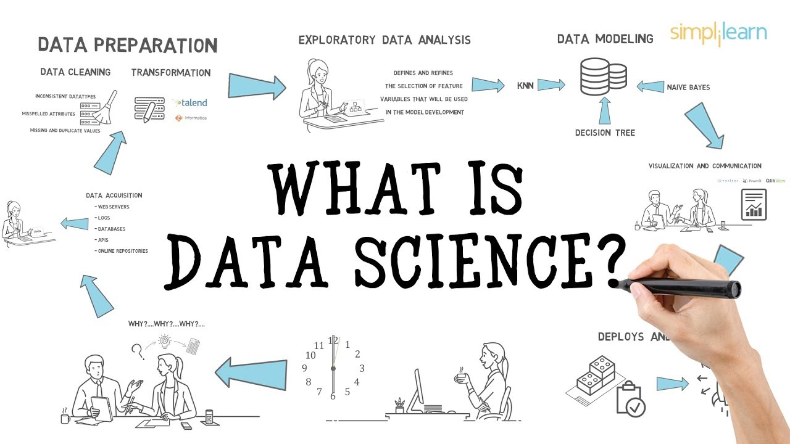
Notes:
After consulting a variety of sources, you will need to narrow your topic. For example, the topic of internet safety is huge, but you could narrow that topic to include internet safety in regards to social media apps that teenagers are using heavily. A topic like that is more specific and will be relevant to your peers. Some questions to think about to help you narrow your topic:
What topics of the research interest me the most?
What topics of the research will interest my audience the most?
What topics will the audience find more engaging? Shocking? Inspiring?

Slide 7
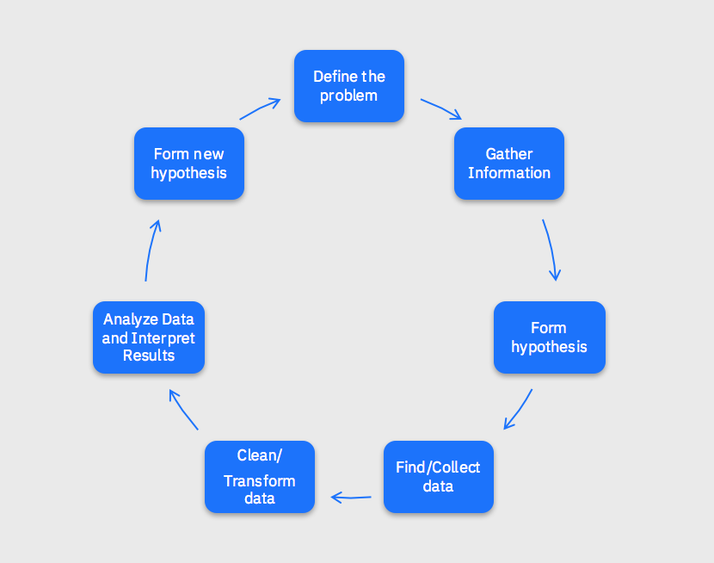
How can we define Data Science
Data Management
Data management is the practice of organizing and maintaining data processes to meet ongoing information lifecycle needs.
Data Analytics
Artificial Intelligence
Artificial intelligence (AI) is the simulation of human intelligence processes by machines, especially computer systems
Data analytics is the science of analyzing raw data in order to make conclusions about that information
Notes:
Now, that you have narrowed your topic, you will want to organize your research in a structure that works. There are some common organizational patterns based on the kind of research you are doing.
Organizational Structures:
Cause and Effect- this kind of structure is great for explaining the causes and effects of a topic
Compare and Contrast- in this pattern you highlight the similarities and differences of the topic
Explain process- this structure is great for outlining a series of steps to follow;
Definition- if you want to make sure your audience understands what something is using illustrations, meanings, clarifying misconceptions, you may want to use this structure
Classification- a common organizational structure is grouping like topics or facts from the research together. For instance, in the internet safety about social media apps, you may organize the research where you look at each social media app one at a time

Slide 8

Data Management
Data management is an administrative process that includes acquiring, validating, storing, protecting, and processing required data to ensure the accessibility, reliability, and timeliness of the data for its users.
Notes:
After you’ve done your research, it’s time to put your presentation together. The first step in the process is to introduce the topic. This is a great time to connect your topic to something that your audience can relate. In other words, why should they listen to all the information you will be sharing in your research presentation? What is in it for them? You may also want to include a graphic or image to grab their attention.
Feel free to duplicate this slide by right-clicking on this slide in the slides pane to the left and select Duplicate Slide.
The next step in your presentation is to state your claim or topic clearly. Your teacher may even call this your thesis. As you state your thesis, you may find that this layout is not the best layout for your claim or topic. You can change the layout by clicking the drop-down menu next to the Layout in the Slides menu section. You can choose Two Content, Comparison, or Picture with Caption. Note: A different layout might change the look of the icons on this page.
You will also want to state your facts. You have done the research now share some of the interesting facts with your audience. Facts do not have to be boring; you can communicate facts in a variety of ways by going to the Insert Tab. In the Insert tab you can:
Insert pictures from your computer or online.
Add a chart
Create some SmartArt
Insert a variety of icons to help your facts come to life. Note: You can change the color of the icons by selecting the icon and then click on the Format tab and then Graphics Fill. From there, you will choose a color from the list or choose More Fill Colors to give you more options.
Since this research presentation is a result of your hard work and searching, you want to make sure you support the claims or points in your presentation with facts from your research findings. Make sure you give the author proper credit for helping you share your ideas. If one of your sources has a video that is relevant to your topic, you can add the video as added support. Keep in mind the length of the video and the amount of time you have for your presentation. For a 5 minute speech, the video should be no longer than 30 seconds.
Questions to consider:
How will you state the author of the source?
Will you need to cite the source on the slide?
What are some ways you can engage your audience so they feel like they are a part of the presentation? Some ideas to consider is by taking a quick poll like: by a show of hands, how many of you think school uniforms are a way to cut down on bullying? Another suggestion is to have them hold up a certain number of fingers to see if they agree or disagree. Finally, you can share a story that the audience can relate to that makes them laugh.
After all the applause, your audience may have some questions. Be prepared to answer some of their questions by making a list of questions you think they might ask. You may also want to share the presentation with them by providing the link to your presentation, if they want more information.

Slide 9
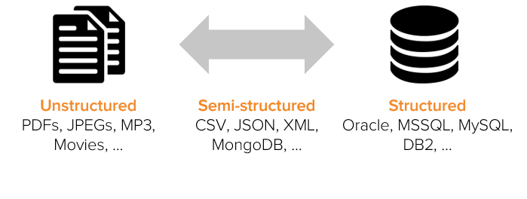
There are three Types of Data
Data
Structured
Semi-Structured
Un-Structured
Notes:
After you’ve done your research, it’s time to put your presentation together. The first step in the process is to introduce the topic. This is a great time to connect your topic to something that your audience can relate. In other words, why should they listen to all the information you will be sharing in your research presentation? What is in it for them? You may also want to include a graphic or image to grab their attention.
Feel free to duplicate this slide by right-clicking on this slide in the slides pane to the left and select Duplicate Slide.
The next step in your presentation is to state your claim or topic clearly. Your teacher may even call this your thesis. As you state your thesis, you may find that this layout is not the best layout for your claim or topic. You can change the layout by clicking the drop-down menu next to the Layout in the Slides menu section. You can choose Two Content, Comparison, or Picture with Caption. Note: A different layout might change the look of the icons on this page.
You will also want to state your facts. You have done the research now share some of the interesting facts with your audience. Facts do not have to be boring; you can communicate facts in a variety of ways by going to the Insert Tab. In the Insert tab you can:
Insert pictures from your computer or online.
Add a chart
Create some SmartArt
Insert a variety of icons to help your facts come to life. Note: You can change the color of the icons by selecting the icon and then click on the Format tab and then Graphics Fill. From there, you will choose a color from the list or choose More Fill Colors to give you more options.
Since this research presentation is a result of your hard work and searching, you want to make sure you support the claims or points in your presentation with facts from your research findings. Make sure you give the author proper credit for helping you share your ideas. If one of your sources has a video that is relevant to your topic, you can add the video as added support. Keep in mind the length of the video and the amount of time you have for your presentation. For a 5 minute speech, the video should be no longer than 30 seconds.
Questions to consider:
How will you state the author of the source?
Will you need to cite the source on the slide?
What are some ways you can engage your audience so they feel like they are a part of the presentation? Some ideas to consider is by taking a quick poll like: by a show of hands, how many of you think school uniforms are a way to cut down on bullying? Another suggestion is to have them hold up a certain number of fingers to see if they agree or disagree. Finally, you can share a story that the audience can relate to that makes them laugh.
After all the applause, your audience may have some questions. Be prepared to answer some of their questions by making a list of questions you think they might ask. You may also want to share the presentation with them by providing the link to your presentation, if they want more information.

Slide 10

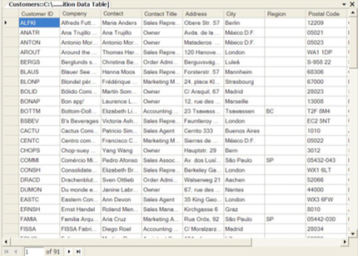
Structured Data
Structured data is data that has been organized into a formatted repository, typically a database, so that its elements can be made addressable for more effective processing and analysis.
Structured Data Example
Notes:
After you’ve done your research, it’s time to put your presentation together. The first step in the process is to introduce the topic. This is a great time to connect your topic to something that your audience can relate. In other words, why should they listen to all the information you will be sharing in your research presentation? What is in it for them? You may also want to include a graphic or image to grab their attention.
Feel free to duplicate this slide by right-clicking on this slide in the slides pane to the left and select Duplicate Slide.
The next step in your presentation is to state your claim or topic clearly. Your teacher may even call this your thesis. As you state your thesis, you may find that this layout is not the best layout for your claim or topic. You can change the layout by clicking the drop-down menu next to the Layout in the Slides menu section. You can choose Two Content, Comparison, or Picture with Caption. Note: A different layout might change the look of the icons on this page.
You will also want to state your facts. You have done the research now share some of the interesting facts with your audience. Facts do not have to be boring; you can communicate facts in a variety of ways by going to the Insert Tab. In the Insert tab you can:
Insert pictures from your computer or online.
Add a chart
Create some SmartArt
Insert a variety of icons to help your facts come to life. Note: You can change the color of the icons by selecting the icon and then click on the Format tab and then Graphics Fill. From there, you will choose a color from the list or choose More Fill Colors to give you more options.
Since this research presentation is a result of your hard work and searching, you want to make sure you support the claims or points in your presentation with facts from your research findings. Make sure you give the author proper credit for helping you share your ideas. If one of your sources has a video that is relevant to your topic, you can add the video as added support. Keep in mind the length of the video and the amount of time you have for your presentation. For a 5 minute speech, the video should be no longer than 30 seconds.
Questions to consider:
How will you state the author of the source?
Will you need to cite the source on the slide?
What are some ways you can engage your audience so they feel like they are a part of the presentation? Some ideas to consider is by taking a quick poll like: by a show of hands, how many of you think school uniforms are a way to cut down on bullying? Another suggestion is to have them hold up a certain number of fingers to see if they agree or disagree. Finally, you can share a story that the audience can relate to that makes them laugh.
After all the applause, your audience may have some questions. Be prepared to answer some of their questions by making a list of questions you think they might ask. You may also want to share the presentation with them by providing the link to your presentation, if they want more information.

Slide 11

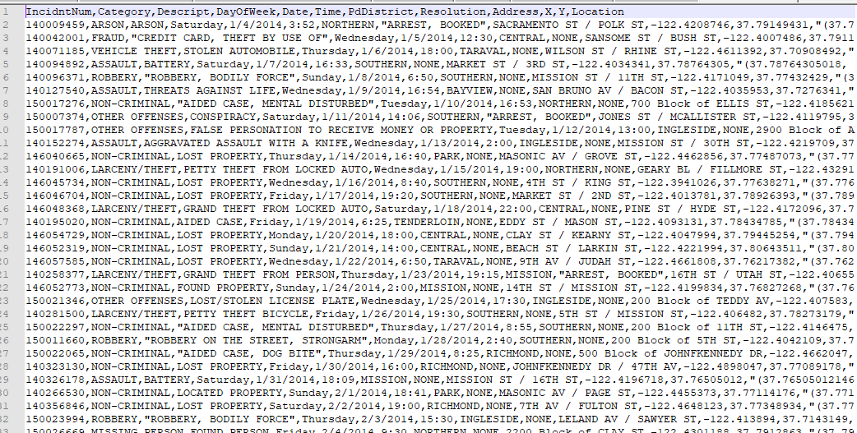
Semi-Structured Data
Semi-structured data is information that doesn’t reside in a relational database but that does have some organizational properties that make it easier to analyze.
Semi-Structured Data Example
Notes:
After you’ve done your research, it’s time to put your presentation together. The first step in the process is to introduce the topic. This is a great time to connect your topic to something that your audience can relate. In other words, why should they listen to all the information you will be sharing in your research presentation? What is in it for them? You may also want to include a graphic or image to grab their attention.
Feel free to duplicate this slide by right-clicking on this slide in the slides pane to the left and select Duplicate Slide.
The next step in your presentation is to state your claim or topic clearly. Your teacher may even call this your thesis. As you state your thesis, you may find that this layout is not the best layout for your claim or topic. You can change the layout by clicking the drop-down menu next to the Layout in the Slides menu section. You can choose Two Content, Comparison, or Picture with Caption. Note: A different layout might change the look of the icons on this page.
You will also want to state your facts. You have done the research now share some of the interesting facts with your audience. Facts do not have to be boring; you can communicate facts in a variety of ways by going to the Insert Tab. In the Insert tab you can:
Insert pictures from your computer or online.
Add a chart
Create some SmartArt
Insert a variety of icons to help your facts come to life. Note: You can change the color of the icons by selecting the icon and then click on the Format tab and then Graphics Fill. From there, you will choose a color from the list or choose More Fill Colors to give you more options.
Since this research presentation is a result of your hard work and searching, you want to make sure you support the claims or points in your presentation with facts from your research findings. Make sure you give the author proper credit for helping you share your ideas. If one of your sources has a video that is relevant to your topic, you can add the video as added support. Keep in mind the length of the video and the amount of time you have for your presentation. For a 5 minute speech, the video should be no longer than 30 seconds.
Questions to consider:
How will you state the author of the source?
Will you need to cite the source on the slide?
What are some ways you can engage your audience so they feel like they are a part of the presentation? Some ideas to consider is by taking a quick poll like: by a show of hands, how many of you think school uniforms are a way to cut down on bullying? Another suggestion is to have them hold up a certain number of fingers to see if they agree or disagree. Finally, you can share a story that the audience can relate to that makes them laugh.
After all the applause, your audience may have some questions. Be prepared to answer some of their questions by making a list of questions you think they might ask. You may also want to share the presentation with them by providing the link to your presentation, if they want more information.

Slide 12

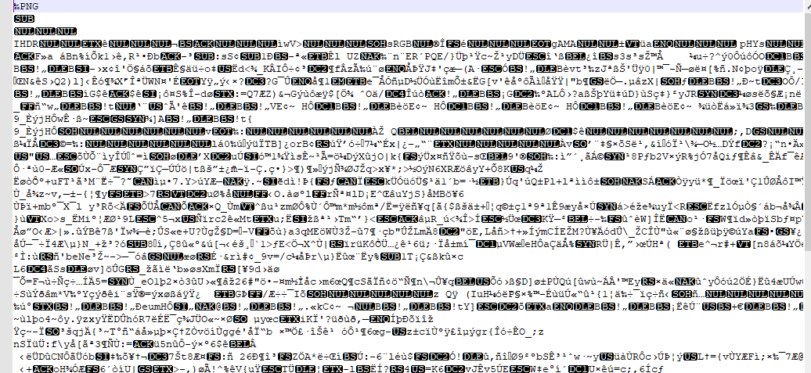
Unstructured Data
Unstructured data is Data that either does not have a pre-defined data model or is not organized in a pre-defined manner
Unstructured Data Example
Notes:
After you’ve done your research, it’s time to put your presentation together. The first step in the process is to introduce the topic. This is a great time to connect your topic to something that your audience can relate. In other words, why should they listen to all the information you will be sharing in your research presentation? What is in it for them? You may also want to include a graphic or image to grab their attention.
Feel free to duplicate this slide by right-clicking on this slide in the slides pane to the left and select Duplicate Slide.
The next step in your presentation is to state your claim or topic clearly. Your teacher may even call this your thesis. As you state your thesis, you may find that this layout is not the best layout for your claim or topic. You can change the layout by clicking the drop-down menu next to the Layout in the Slides menu section. You can choose Two Content, Comparison, or Picture with Caption. Note: A different layout might change the look of the icons on this page.
You will also want to state your facts. You have done the research now share some of the interesting facts with your audience. Facts do not have to be boring; you can communicate facts in a variety of ways by going to the Insert Tab. In the Insert tab you can:
Insert pictures from your computer or online.
Add a chart
Create some SmartArt
Insert a variety of icons to help your facts come to life. Note: You can change the color of the icons by selecting the icon and then click on the Format tab and then Graphics Fill. From there, you will choose a color from the list or choose More Fill Colors to give you more options.
Since this research presentation is a result of your hard work and searching, you want to make sure you support the claims or points in your presentation with facts from your research findings. Make sure you give the author proper credit for helping you share your ideas. If one of your sources has a video that is relevant to your topic, you can add the video as added support. Keep in mind the length of the video and the amount of time you have for your presentation. For a 5 minute speech, the video should be no longer than 30 seconds.
Questions to consider:
How will you state the author of the source?
Will you need to cite the source on the slide?
What are some ways you can engage your audience so they feel like they are a part of the presentation? Some ideas to consider is by taking a quick poll like: by a show of hands, how many of you think school uniforms are a way to cut down on bullying? Another suggestion is to have them hold up a certain number of fingers to see if they agree or disagree. Finally, you can share a story that the audience can relate to that makes them laugh.
After all the applause, your audience may have some questions. Be prepared to answer some of their questions by making a list of questions you think they might ask. You may also want to share the presentation with them by providing the link to your presentation, if they want more information.

Slide 13

Data Management Tools
There are Various Types of Data Management Tools for Each and every structure data so they are
Notes:
After you’ve done your research, it’s time to put your presentation together. The first step in the process is to introduce the topic. This is a great time to connect your topic to something that your audience can relate. In other words, why should they listen to all the information you will be sharing in your research presentation? What is in it for them? You may also want to include a graphic or image to grab their attention.
Feel free to duplicate this slide by right-clicking on this slide in the slides pane to the left and select Duplicate Slide.
The next step in your presentation is to state your claim or topic clearly. Your teacher may even call this your thesis. As you state your thesis, you may find that this layout is not the best layout for your claim or topic. You can change the layout by clicking the drop-down menu next to the Layout in the Slides menu section. You can choose Two Content, Comparison, or Picture with Caption. Note: A different layout might change the look of the icons on this page.
You will also want to state your facts. You have done the research now share some of the interesting facts with your audience. Facts do not have to be boring; you can communicate facts in a variety of ways by going to the Insert Tab. In the Insert tab you can:
Insert pictures from your computer or online.
Add a chart
Create some SmartArt
Insert a variety of icons to help your facts come to life. Note: You can change the color of the icons by selecting the icon and then click on the Format tab and then Graphics Fill. From there, you will choose a color from the list or choose More Fill Colors to give you more options.
Since this research presentation is a result of your hard work and searching, you want to make sure you support the claims or points in your presentation with facts from your research findings. Make sure you give the author proper credit for helping you share your ideas. If one of your sources has a video that is relevant to your topic, you can add the video as added support. Keep in mind the length of the video and the amount of time you have for your presentation. For a 5 minute speech, the video should be no longer than 30 seconds.
Questions to consider:
How will you state the author of the source?
Will you need to cite the source on the slide?
What are some ways you can engage your audience so they feel like they are a part of the presentation? Some ideas to consider is by taking a quick poll like: by a show of hands, how many of you think school uniforms are a way to cut down on bullying? Another suggestion is to have them hold up a certain number of fingers to see if they agree or disagree. Finally, you can share a story that the audience can relate to that makes them laugh.
After all the applause, your audience may have some questions. Be prepared to answer some of their questions by making a list of questions you think they might ask. You may also want to share the presentation with them by providing the link to your presentation, if they want more information.

Slide 14

Data Management Tools
For Structured Data
There are some common Structured data Management Tools You may know Most of it Like Mysql,Oracle,SQl,Excel etc. They are easy to use and user friendly
Notes:
After you’ve done your research, it’s time to put your presentation together. The first step in the process is to introduce the topic. This is a great time to connect your topic to something that your audience can relate. In other words, why should they listen to all the information you will be sharing in your research presentation? What is in it for them? You may also want to include a graphic or image to grab their attention.
Feel free to duplicate this slide by right-clicking on this slide in the slides pane to the left and select Duplicate Slide.
The next step in your presentation is to state your claim or topic clearly. Your teacher may even call this your thesis. As you state your thesis, you may find that this layout is not the best layout for your claim or topic. You can change the layout by clicking the drop-down menu next to the Layout in the Slides menu section. You can choose Two Content, Comparison, or Picture with Caption. Note: A different layout might change the look of the icons on this page.
You will also want to state your facts. You have done the research now share some of the interesting facts with your audience. Facts do not have to be boring; you can communicate facts in a variety of ways by going to the Insert Tab. In the Insert tab you can:
Insert pictures from your computer or online.
Add a chart
Create some SmartArt
Insert a variety of icons to help your facts come to life. Note: You can change the color of the icons by selecting the icon and then click on the Format tab and then Graphics Fill. From there, you will choose a color from the list or choose More Fill Colors to give you more options.
Since this research presentation is a result of your hard work and searching, you want to make sure you support the claims or points in your presentation with facts from your research findings. Make sure you give the author proper credit for helping you share your ideas. If one of your sources has a video that is relevant to your topic, you can add the video as added support. Keep in mind the length of the video and the amount of time you have for your presentation. For a 5 minute speech, the video should be no longer than 30 seconds.
Questions to consider:
How will you state the author of the source?
Will you need to cite the source on the slide?
What are some ways you can engage your audience so they feel like they are a part of the presentation? Some ideas to consider is by taking a quick poll like: by a show of hands, how many of you think school uniforms are a way to cut down on bullying? Another suggestion is to have them hold up a certain number of fingers to see if they agree or disagree. Finally, you can share a story that the audience can relate to that makes them laugh.
After all the applause, your audience may have some questions. Be prepared to answer some of their questions by making a list of questions you think they might ask. You may also want to share the presentation with them by providing the link to your presentation, if they want more information.

Slide 15

For Semi-Structured and Unstructured data
Data Management Tools
When there comes a semi structured data or Unstructured data that mean big data management tool the name come Hadoop. IT is a popular big-data Management Tool
Notes:
After you’ve done your research, it’s time to put your presentation together. The first step in the process is to introduce the topic. This is a great time to connect your topic to something that your audience can relate. In other words, why should they listen to all the information you will be sharing in your research presentation? What is in it for them? You may also want to include a graphic or image to grab their attention.
Feel free to duplicate this slide by right-clicking on this slide in the slides pane to the left and select Duplicate Slide.
The next step in your presentation is to state your claim or topic clearly. Your teacher may even call this your thesis. As you state your thesis, you may find that this layout is not the best layout for your claim or topic. You can change the layout by clicking the drop-down menu next to the Layout in the Slides menu section. You can choose Two Content, Comparison, or Picture with Caption. Note: A different layout might change the look of the icons on this page.
You will also want to state your facts. You have done the research now share some of the interesting facts with your audience. Facts do not have to be boring; you can communicate facts in a variety of ways by going to the Insert Tab. In the Insert tab you can:
Insert pictures from your computer or online.
Add a chart
Create some SmartArt
Insert a variety of icons to help your facts come to life. Note: You can change the color of the icons by selecting the icon and then click on the Format tab and then Graphics Fill. From there, you will choose a color from the list or choose More Fill Colors to give you more options.
Since this research presentation is a result of your hard work and searching, you want to make sure you support the claims or points in your presentation with facts from your research findings. Make sure you give the author proper credit for helping you share your ideas. If one of your sources has a video that is relevant to your topic, you can add the video as added support. Keep in mind the length of the video and the amount of time you have for your presentation. For a 5 minute speech, the video should be no longer than 30 seconds.
Questions to consider:
How will you state the author of the source?
Will you need to cite the source on the slide?
What are some ways you can engage your audience so they feel like they are a part of the presentation? Some ideas to consider is by taking a quick poll like: by a show of hands, how many of you think school uniforms are a way to cut down on bullying? Another suggestion is to have them hold up a certain number of fingers to see if they agree or disagree. Finally, you can share a story that the audience can relate to that makes them laugh.
After all the applause, your audience may have some questions. Be prepared to answer some of their questions by making a list of questions you think they might ask. You may also want to share the presentation with them by providing the link to your presentation, if they want more information.

Slide 16

Data Analysis
Data Analysis is the process of systematically applying statistical and/or logical techniques to describe and illustrate, condense and recap, and evaluate data
Notes:
After you’ve done your research, it’s time to put your presentation together. The first step in the process is to introduce the topic. This is a great time to connect your topic to something that your audience can relate. In other words, why should they listen to all the information you will be sharing in your research presentation? What is in it for them? You may also want to include a graphic or image to grab their attention.
Feel free to duplicate this slide by right-clicking on this slide in the slides pane to the left and select Duplicate Slide.
The next step in your presentation is to state your claim or topic clearly. Your teacher may even call this your thesis. As you state your thesis, you may find that this layout is not the best layout for your claim or topic. You can change the layout by clicking the drop-down menu next to the Layout in the Slides menu section. You can choose Two Content, Comparison, or Picture with Caption. Note: A different layout might change the look of the icons on this page.
You will also want to state your facts. You have done the research now share some of the interesting facts with your audience. Facts do not have to be boring; you can communicate facts in a variety of ways by going to the Insert Tab. In the Insert tab you can:
Insert pictures from your computer or online.
Add a chart
Create some SmartArt
Insert a variety of icons to help your facts come to life. Note: You can change the color of the icons by selecting the icon and then click on the Format tab and then Graphics Fill. From there, you will choose a color from the list or choose More Fill Colors to give you more options.
Since this research presentation is a result of your hard work and searching, you want to make sure you support the claims or points in your presentation with facts from your research findings. Make sure you give the author proper credit for helping you share your ideas. If one of your sources has a video that is relevant to your topic, you can add the video as added support. Keep in mind the length of the video and the amount of time you have for your presentation. For a 5 minute speech, the video should be no longer than 30 seconds.
Questions to consider:
How will you state the author of the source?
Will you need to cite the source on the slide?
What are some ways you can engage your audience so they feel like they are a part of the presentation? Some ideas to consider is by taking a quick poll like: by a show of hands, how many of you think school uniforms are a way to cut down on bullying? Another suggestion is to have them hold up a certain number of fingers to see if they agree or disagree. Finally, you can share a story that the audience can relate to that makes them laugh.
After all the applause, your audience may have some questions. Be prepared to answer some of their questions by making a list of questions you think they might ask. You may also want to share the presentation with them by providing the link to your presentation, if they want more information.

Slide 17
Data Analysis
Idea
Analysis
Data
Notes:
After you’ve done your research, it’s time to put your presentation together. The first step in the process is to introduce the topic. This is a great time to connect your topic to something that your audience can relate. In other words, why should they listen to all the information you will be sharing in your research presentation? What is in it for them? You may also want to include a graphic or image to grab their attention.
Feel free to duplicate this slide by right-clicking on this slide in the slides pane to the left and select Duplicate Slide.
The next step in your presentation is to state your claim or topic clearly. Your teacher may even call this your thesis. As you state your thesis, you may find that this layout is not the best layout for your claim or topic. You can change the layout by clicking the drop-down menu next to the Layout in the Slides menu section. You can choose Two Content, Comparison, or Picture with Caption. Note: A different layout might change the look of the icons on this page.
You will also want to state your facts. You have done the research now share some of the interesting facts with your audience. Facts do not have to be boring; you can communicate facts in a variety of ways by going to the Insert Tab. In the Insert tab you can:
Insert pictures from your computer or online.
Add a chart
Create some SmartArt
Insert a variety of icons to help your facts come to life. Note: You can change the color of the icons by selecting the icon and then click on the Format tab and then Graphics Fill. From there, you will choose a color from the list or choose More Fill Colors to give you more options.
Since this research presentation is a result of your hard work and searching, you want to make sure you support the claims or points in your presentation with facts from your research findings. Make sure you give the author proper credit for helping you share your ideas. If one of your sources has a video that is relevant to your topic, you can add the video as added support. Keep in mind the length of the video and the amount of time you have for your presentation. For a 5 minute speech, the video should be no longer than 30 seconds.
Questions to consider:
How will you state the author of the source?
Will you need to cite the source on the slide?
What are some ways you can engage your audience so they feel like they are a part of the presentation? Some ideas to consider is by taking a quick poll like: by a show of hands, how many of you think school uniforms are a way to cut down on bullying? Another suggestion is to have them hold up a certain number of fingers to see if they agree or disagree. Finally, you can share a story that the audience can relate to that makes them laugh.
After all the applause, your audience may have some questions. Be prepared to answer some of their questions by making a list of questions you think they might ask. You may also want to share the presentation with them by providing the link to your presentation, if they want more information.

Slide 18
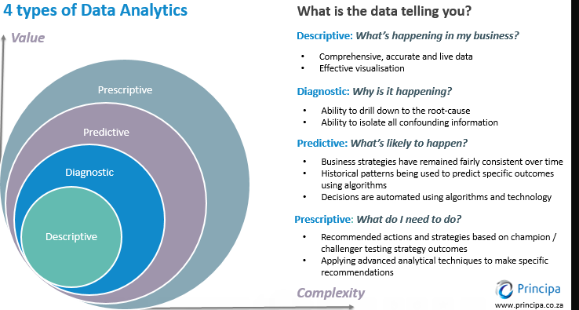
Notes:
After you’ve done your research, it’s time to put your presentation together. The first step in the process is to introduce the topic. This is a great time to connect your topic to something that your audience can relate. In other words, why should they listen to all the information you will be sharing in your research presentation? What is in it for them? You may also want to include a graphic or image to grab their attention.
Feel free to duplicate this slide by right-clicking on this slide in the slides pane to the left and select Duplicate Slide.
The next step in your presentation is to state your claim or topic clearly. Your teacher may even call this your thesis. As you state your thesis, you may find that this layout is not the best layout for your claim or topic. You can change the layout by clicking the drop-down menu next to the Layout in the Slides menu section. You can choose Two Content, Comparison, or Picture with Caption. Note: A different layout might change the look of the icons on this page.
You will also want to state your facts. You have done the research now share some of the interesting facts with your audience. Facts do not have to be boring; you can communicate facts in a variety of ways by going to the Insert Tab. In the Insert tab you can:
Insert pictures from your computer or online.
Add a chart
Create some SmartArt
Insert a variety of icons to help your facts come to life. Note: You can change the color of the icons by selecting the icon and then click on the Format tab and then Graphics Fill. From there, you will choose a color from the list or choose More Fill Colors to give you more options.
Since this research presentation is a result of your hard work and searching, you want to make sure you support the claims or points in your presentation with facts from your research findings. Make sure you give the author proper credit for helping you share your ideas. If one of your sources has a video that is relevant to your topic, you can add the video as added support. Keep in mind the length of the video and the amount of time you have for your presentation. For a 5 minute speech, the video should be no longer than 30 seconds.
Questions to consider:
How will you state the author of the source?
Will you need to cite the source on the slide?
What are some ways you can engage your audience so they feel like they are a part of the presentation? Some ideas to consider is by taking a quick poll like: by a show of hands, how many of you think school uniforms are a way to cut down on bullying? Another suggestion is to have them hold up a certain number of fingers to see if they agree or disagree. Finally, you can share a story that the audience can relate to that makes them laugh.
After all the applause, your audience may have some questions. Be prepared to answer some of their questions by making a list of questions you think they might ask. You may also want to share the presentation with them by providing the link to your presentation, if they want more information.

Slide 19
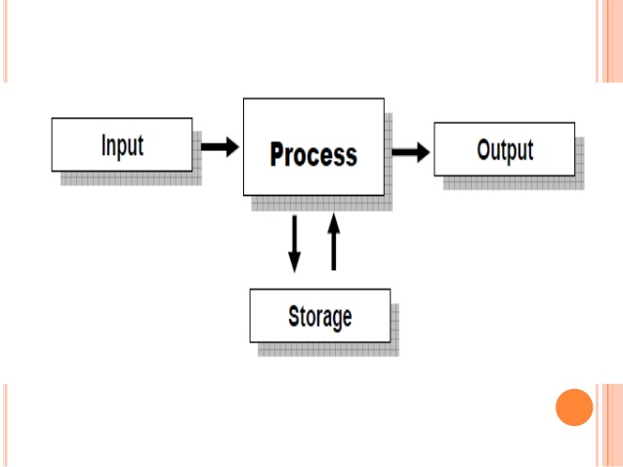
Data Processing
Data Procession start with a data in it’s row form and convert it into more readable format giving it the context necessary to be interpreted by computer utilize by employee throughout the Organization
Notes:
After you’ve done your research, it’s time to put your presentation together. The first step in the process is to introduce the topic. This is a great time to connect your topic to something that your audience can relate. In other words, why should they listen to all the information you will be sharing in your research presentation? What is in it for them? You may also want to include a graphic or image to grab their attention.
Feel free to duplicate this slide by right-clicking on this slide in the slides pane to the left and select Duplicate Slide.
The next step in your presentation is to state your claim or topic clearly. Your teacher may even call this your thesis. As you state your thesis, you may find that this layout is not the best layout for your claim or topic. You can change the layout by clicking the drop-down menu next to the Layout in the Slides menu section. You can choose Two Content, Comparison, or Picture with Caption. Note: A different layout might change the look of the icons on this page.
You will also want to state your facts. You have done the research now share some of the interesting facts with your audience. Facts do not have to be boring; you can communicate facts in a variety of ways by going to the Insert Tab. In the Insert tab you can:
Insert pictures from your computer or online.
Add a chart
Create some SmartArt
Insert a variety of icons to help your facts come to life. Note: You can change the color of the icons by selecting the icon and then click on the Format tab and then Graphics Fill. From there, you will choose a color from the list or choose More Fill Colors to give you more options.
Since this research presentation is a result of your hard work and searching, you want to make sure you support the claims or points in your presentation with facts from your research findings. Make sure you give the author proper credit for helping you share your ideas. If one of your sources has a video that is relevant to your topic, you can add the video as added support. Keep in mind the length of the video and the amount of time you have for your presentation. For a 5 minute speech, the video should be no longer than 30 seconds.
Questions to consider:
How will you state the author of the source?
Will you need to cite the source on the slide?
What are some ways you can engage your audience so they feel like they are a part of the presentation? Some ideas to consider is by taking a quick poll like: by a show of hands, how many of you think school uniforms are a way to cut down on bullying? Another suggestion is to have them hold up a certain number of fingers to see if they agree or disagree. Finally, you can share a story that the audience can relate to that makes them laugh.
After all the applause, your audience may have some questions. Be prepared to answer some of their questions by making a list of questions you think they might ask. You may also want to share the presentation with them by providing the link to your presentation, if they want more information.

Slide 20
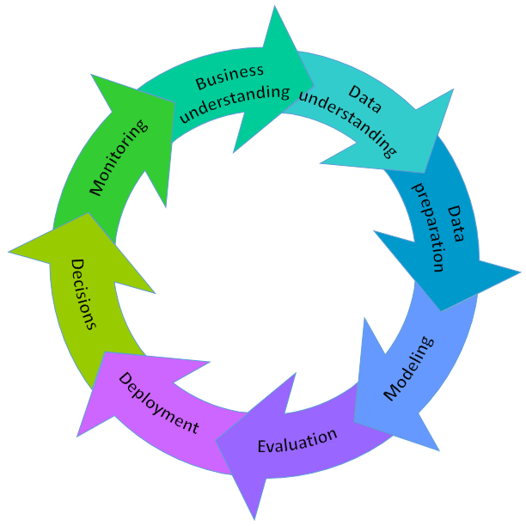
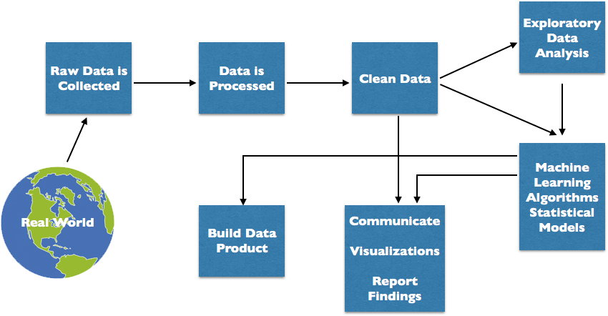
Data Science Process
Notes:
After you’ve done your research, it’s time to put your presentation together. The first step in the process is to introduce the topic. This is a great time to connect your topic to something that your audience can relate. In other words, why should they listen to all the information you will be sharing in your research presentation? What is in it for them? You may also want to include a graphic or image to grab their attention.
Feel free to duplicate this slide by right-clicking on this slide in the slides pane to the left and select Duplicate Slide.
The next step in your presentation is to state your claim or topic clearly. Your teacher may even call this your thesis. As you state your thesis, you may find that this layout is not the best layout for your claim or topic. You can change the layout by clicking the drop-down menu next to the Layout in the Slides menu section. You can choose Two Content, Comparison, or Picture with Caption. Note: A different layout might change the look of the icons on this page.
You will also want to state your facts. You have done the research now share some of the interesting facts with your audience. Facts do not have to be boring; you can communicate facts in a variety of ways by going to the Insert Tab. In the Insert tab you can:
Insert pictures from your computer or online.
Add a chart
Create some SmartArt
Insert a variety of icons to help your facts come to life. Note: You can change the color of the icons by selecting the icon and then click on the Format tab and then Graphics Fill. From there, you will choose a color from the list or choose More Fill Colors to give you more options.
Since this research presentation is a result of your hard work and searching, you want to make sure you support the claims or points in your presentation with facts from your research findings. Make sure you give the author proper credit for helping you share your ideas. If one of your sources has a video that is relevant to your topic, you can add the video as added support. Keep in mind the length of the video and the amount of time you have for your presentation. For a 5 minute speech, the video should be no longer than 30 seconds.
Questions to consider:
How will you state the author of the source?
Will you need to cite the source on the slide?
What are some ways you can engage your audience so they feel like they are a part of the presentation? Some ideas to consider is by taking a quick poll like: by a show of hands, how many of you think school uniforms are a way to cut down on bullying? Another suggestion is to have them hold up a certain number of fingers to see if they agree or disagree. Finally, you can share a story that the audience can relate to that makes them laugh.
After all the applause, your audience may have some questions. Be prepared to answer some of their questions by making a list of questions you think they might ask. You may also want to share the presentation with them by providing the link to your presentation, if they want more information.

Slide 21

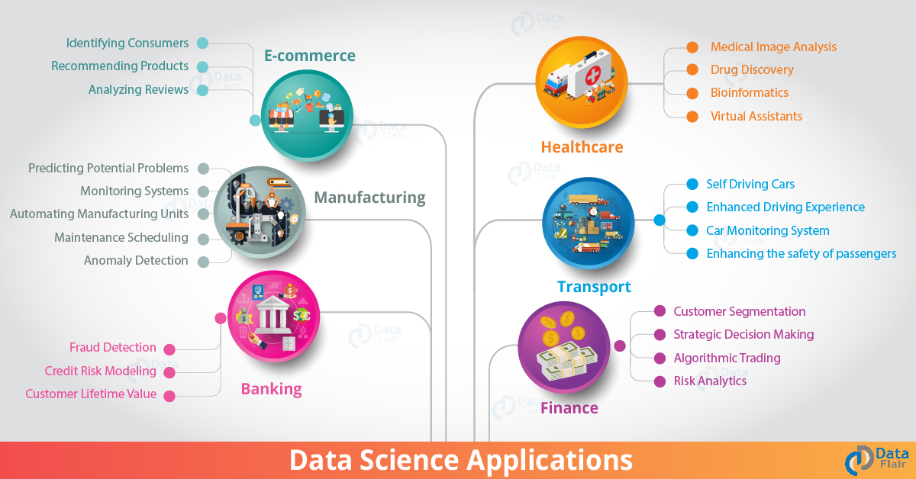
Data science Application

Slide 22



Data Analysis Tool
Python
Notes:
After you’ve done your research, it’s time to put your presentation together. The first step in the process is to introduce the topic. This is a great time to connect your topic to something that your audience can relate. In other words, why should they listen to all the information you will be sharing in your research presentation? What is in it for them? You may also want to include a graphic or image to grab their attention.
Feel free to duplicate this slide by right-clicking on this slide in the slides pane to the left and select Duplicate Slide.
The next step in your presentation is to state your claim or topic clearly. Your teacher may even call this your thesis. As you state your thesis, you may find that this layout is not the best layout for your claim or topic. You can change the layout by clicking the drop-down menu next to the Layout in the Slides menu section. You can choose Two Content, Comparison, or Picture with Caption. Note: A different layout might change the look of the icons on this page.
You will also want to state your facts. You have done the research now share some of the interesting facts with your audience. Facts do not have to be boring; you can communicate facts in a variety of ways by going to the Insert Tab. In the Insert tab you can:
Insert pictures from your computer or online.
Add a chart
Create some SmartArt
Insert a variety of icons to help your facts come to life. Note: You can change the color of the icons by selecting the icon and then click on the Format tab and then Graphics Fill. From there, you will choose a color from the list or choose More Fill Colors to give you more options.
Since this research presentation is a result of your hard work and searching, you want to make sure you support the claims or points in your presentation with facts from your research findings. Make sure you give the author proper credit for helping you share your ideas. If one of your sources has a video that is relevant to your topic, you can add the video as added support. Keep in mind the length of the video and the amount of time you have for your presentation. For a 5 minute speech, the video should be no longer than 30 seconds.
Questions to consider:
How will you state the author of the source?
Will you need to cite the source on the slide?
What are some ways you can engage your audience so they feel like they are a part of the presentation? Some ideas to consider is by taking a quick poll like: by a show of hands, how many of you think school uniforms are a way to cut down on bullying? Another suggestion is to have them hold up a certain number of fingers to see if they agree or disagree. Finally, you can share a story that the audience can relate to that makes them laugh.
After all the applause, your audience may have some questions. Be prepared to answer some of their questions by making a list of questions you think they might ask. You may also want to share the presentation with them by providing the link to your presentation, if they want more information.

Slide 23


Jupyter Notebook
Notes:
After you’ve done your research, it’s time to put your presentation together. The first step in the process is to introduce the topic. This is a great time to connect your topic to something that your audience can relate. In other words, why should they listen to all the information you will be sharing in your research presentation? What is in it for them? You may also want to include a graphic or image to grab their attention.
Feel free to duplicate this slide by right-clicking on this slide in the slides pane to the left and select Duplicate Slide.
The next step in your presentation is to state your claim or topic clearly. Your teacher may even call this your thesis. As you state your thesis, you may find that this layout is not the best layout for your claim or topic. You can change the layout by clicking the drop-down menu next to the Layout in the Slides menu section. You can choose Two Content, Comparison, or Picture with Caption. Note: A different layout might change the look of the icons on this page.
You will also want to state your facts. You have done the research now share some of the interesting facts with your audience. Facts do not have to be boring; you can communicate facts in a variety of ways by going to the Insert Tab. In the Insert tab you can:
Insert pictures from your computer or online.
Add a chart
Create some SmartArt
Insert a variety of icons to help your facts come to life. Note: You can change the color of the icons by selecting the icon and then click on the Format tab and then Graphics Fill. From there, you will choose a color from the list or choose More Fill Colors to give you more options.
Since this research presentation is a result of your hard work and searching, you want to make sure you support the claims or points in your presentation with facts from your research findings. Make sure you give the author proper credit for helping you share your ideas. If one of your sources has a video that is relevant to your topic, you can add the video as added support. Keep in mind the length of the video and the amount of time you have for your presentation. For a 5 minute speech, the video should be no longer than 30 seconds.
Questions to consider:
How will you state the author of the source?
Will you need to cite the source on the slide?
What are some ways you can engage your audience so they feel like they are a part of the presentation? Some ideas to consider is by taking a quick poll like: by a show of hands, how many of you think school uniforms are a way to cut down on bullying? Another suggestion is to have them hold up a certain number of fingers to see if they agree or disagree. Finally, you can share a story that the audience can relate to that makes them laugh.
After all the applause, your audience may have some questions. Be prepared to answer some of their questions by making a list of questions you think they might ask. You may also want to share the presentation with them by providing the link to your presentation, if they want more information.

Slide 24
Jupyter
The Jupyter Notebook is an open-source web application that allows you to create and share documents that contain live code, equations, visualizations and narrative text
Uses: it is use for data cleaning and transformation, numerical simulation, statistical modeling, data visualization, machine learning, and much more
Notes:
After you’ve done your research, it’s time to put your presentation together. The first step in the process is to introduce the topic. This is a great time to connect your topic to something that your audience can relate. In other words, why should they listen to all the information you will be sharing in your research presentation? What is in it for them? You may also want to include a graphic or image to grab their attention.
Feel free to duplicate this slide by right-clicking on this slide in the slides pane to the left and select Duplicate Slide.
The next step in your presentation is to state your claim or topic clearly. Your teacher may even call this your thesis. As you state your thesis, you may find that this layout is not the best layout for your claim or topic. You can change the layout by clicking the drop-down menu next to the Layout in the Slides menu section. You can choose Two Content, Comparison, or Picture with Caption. Note: A different layout might change the look of the icons on this page.
You will also want to state your facts. You have done the research now share some of the interesting facts with your audience. Facts do not have to be boring; you can communicate facts in a variety of ways by going to the Insert Tab. In the Insert tab you can:
Insert pictures from your computer or online.
Add a chart
Create some SmartArt
Insert a variety of icons to help your facts come to life. Note: You can change the color of the icons by selecting the icon and then click on the Format tab and then Graphics Fill. From there, you will choose a color from the list or choose More Fill Colors to give you more options.
Since this research presentation is a result of your hard work and searching, you want to make sure you support the claims or points in your presentation with facts from your research findings. Make sure you give the author proper credit for helping you share your ideas. If one of your sources has a video that is relevant to your topic, you can add the video as added support. Keep in mind the length of the video and the amount of time you have for your presentation. For a 5 minute speech, the video should be no longer than 30 seconds.
Questions to consider:
How will you state the author of the source?
Will you need to cite the source on the slide?
What are some ways you can engage your audience so they feel like they are a part of the presentation? Some ideas to consider is by taking a quick poll like: by a show of hands, how many of you think school uniforms are a way to cut down on bullying? Another suggestion is to have them hold up a certain number of fingers to see if they agree or disagree. Finally, you can share a story that the audience can relate to that makes them laugh.
After all the applause, your audience may have some questions. Be prepared to answer some of their questions by making a list of questions you think they might ask. You may also want to share the presentation with them by providing the link to your presentation, if they want more information.

Slide 25

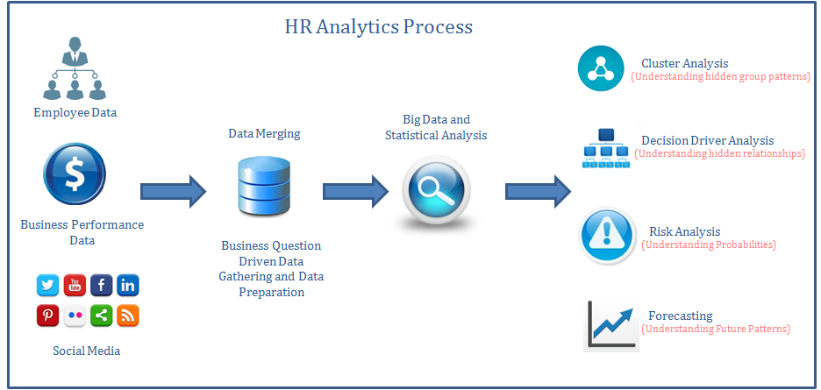
Data Science In HR Analysis
Notes:
After you’ve done your research, it’s time to put your presentation together. The first step in the process is to introduce the topic. This is a great time to connect your topic to something that your audience can relate. In other words, why should they listen to all the information you will be sharing in your research presentation? What is in it for them? You may also want to include a graphic or image to grab their attention.
Feel free to duplicate this slide by right-clicking on this slide in the slides pane to the left and select Duplicate Slide.
The next step in your presentation is to state your claim or topic clearly. Your teacher may even call this your thesis. As you state your thesis, you may find that this layout is not the best layout for your claim or topic. You can change the layout by clicking the drop-down menu next to the Layout in the Slides menu section. You can choose Two Content, Comparison, or Picture with Caption. Note: A different layout might change the look of the icons on this page.
You will also want to state your facts. You have done the research now share some of the interesting facts with your audience. Facts do not have to be boring; you can communicate facts in a variety of ways by going to the Insert Tab. In the Insert tab you can:
Insert pictures from your computer or online.
Add a chart
Create some SmartArt
Insert a variety of icons to help your facts come to life. Note: You can change the color of the icons by selecting the icon and then click on the Format tab and then Graphics Fill. From there, you will choose a color from the list or choose More Fill Colors to give you more options.
Since this research presentation is a result of your hard work and searching, you want to make sure you support the claims or points in your presentation with facts from your research findings. Make sure you give the author proper credit for helping you share your ideas. If one of your sources has a video that is relevant to your topic, you can add the video as added support. Keep in mind the length of the video and the amount of time you have for your presentation. For a 5 minute speech, the video should be no longer than 30 seconds.
Questions to consider:
How will you state the author of the source?
Will you need to cite the source on the slide?
What are some ways you can engage your audience so they feel like they are a part of the presentation? Some ideas to consider is by taking a quick poll like: by a show of hands, how many of you think school uniforms are a way to cut down on bullying? Another suggestion is to have them hold up a certain number of fingers to see if they agree or disagree. Finally, you can share a story that the audience can relate to that makes them laugh.
After all the applause, your audience may have some questions. Be prepared to answer some of their questions by making a list of questions you think they might ask. You may also want to share the presentation with them by providing the link to your presentation, if they want more information.

Slide 26
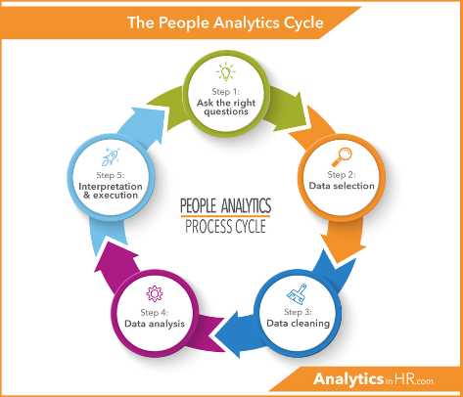
Data Science In HR Analysis
Notes:
After you’ve done your research, it’s time to put your presentation together. The first step in the process is to introduce the topic. This is a great time to connect your topic to something that your audience can relate. In other words, why should they listen to all the information you will be sharing in your research presentation? What is in it for them? You may also want to include a graphic or image to grab their attention.
Feel free to duplicate this slide by right-clicking on this slide in the slides pane to the left and select Duplicate Slide.
The next step in your presentation is to state your claim or topic clearly. Your teacher may even call this your thesis. As you state your thesis, you may find that this layout is not the best layout for your claim or topic. You can change the layout by clicking the drop-down menu next to the Layout in the Slides menu section. You can choose Two Content, Comparison, or Picture with Caption. Note: A different layout might change the look of the icons on this page.
You will also want to state your facts. You have done the research now share some of the interesting facts with your audience. Facts do not have to be boring; you can communicate facts in a variety of ways by going to the Insert Tab. In the Insert tab you can:
Insert pictures from your computer or online.
Add a chart
Create some SmartArt
Insert a variety of icons to help your facts come to life. Note: You can change the color of the icons by selecting the icon and then click on the Format tab and then Graphics Fill. From there, you will choose a color from the list or choose More Fill Colors to give you more options.
Since this research presentation is a result of your hard work and searching, you want to make sure you support the claims or points in your presentation with facts from your research findings. Make sure you give the author proper credit for helping you share your ideas. If one of your sources has a video that is relevant to your topic, you can add the video as added support. Keep in mind the length of the video and the amount of time you have for your presentation. For a 5 minute speech, the video should be no longer than 30 seconds.
Questions to consider:
How will you state the author of the source?
Will you need to cite the source on the slide?
What are some ways you can engage your audience so they feel like they are a part of the presentation? Some ideas to consider is by taking a quick poll like: by a show of hands, how many of you think school uniforms are a way to cut down on bullying? Another suggestion is to have them hold up a certain number of fingers to see if they agree or disagree. Finally, you can share a story that the audience can relate to that makes them laugh.
After all the applause, your audience may have some questions. Be prepared to answer some of their questions by making a list of questions you think they might ask. You may also want to share the presentation with them by providing the link to your presentation, if they want more information.

Slide 27

Data Description
Data description refers to how the results from research studies are organized, summarized, and characterized statistically.

Slide 28

Employee –Turnover HR Data Analysis Using Python
Project

Slide 29

Why We Use Python For HR Data Analysis?
Here are some of the important factors, for that we preferred Use Python over other data science tools:
Open source
Easy to learn
Scalability
Choice of data science libraries
Python community
Graphics and visualization

Slide 30
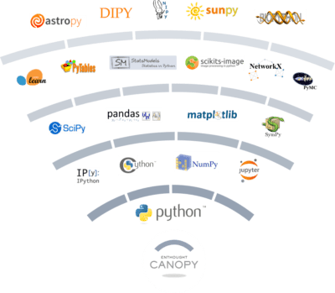
There are Some Library Which we used on This project
Pandas
Numpy
Matplotlib
Warning
Sklearn

Slide 31

About Our Dataset
The Given Dataset name is hrdataset.csv
It’s a csv data format that mean it’s a semi-structured data
This Dataset contain 15000 Employee details
With this Dataset we have to predict All employee performance

Slide 32
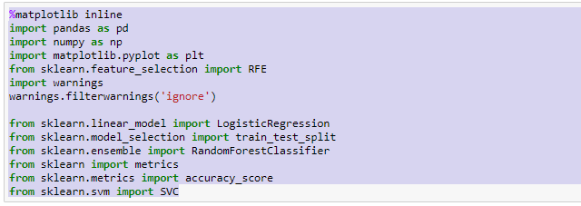
Project Implementation
Firstly We have to Import some Libraries From python Library

Slide 33
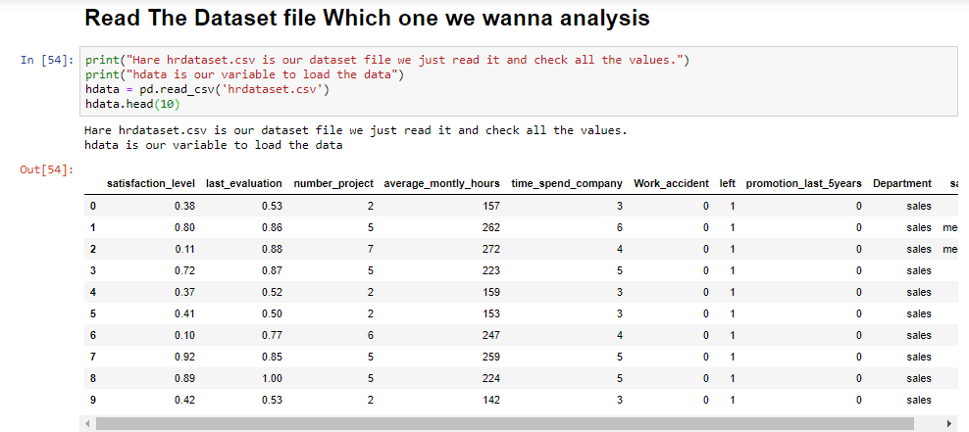
Load The Dataset In Jupyter Notebook
After import All necessary libraries we load our Dataset file which name is hdataset.csv and use head function to read some rows.

Slide 34
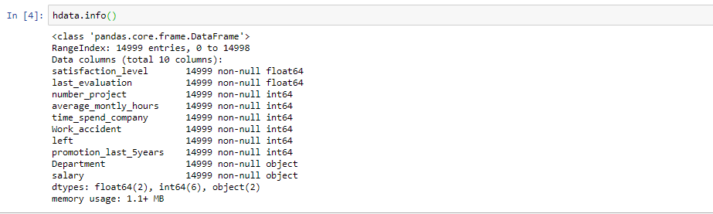
Using Info Function
After Load the dataset in hdata we use info function to know all information about this dataset

Slide 35
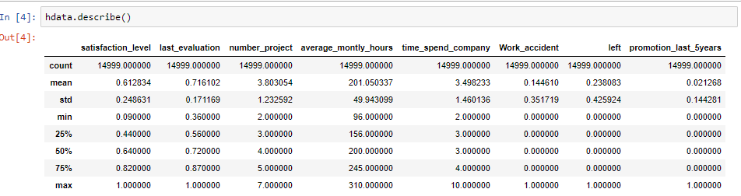
Used Describe Function
After Load the Dataset we use describe() method will give us some basic summary statistics about various fields of the dataset.

Slide 36
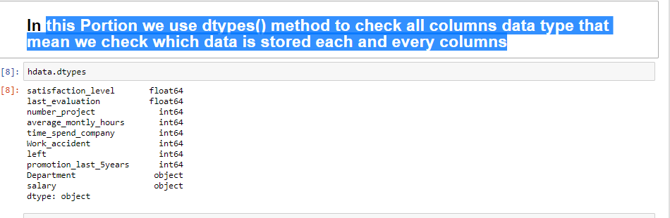
Using Dtype()
we use dtypes () method to check all columns data type which data is stored each and every columns.

Slide 37
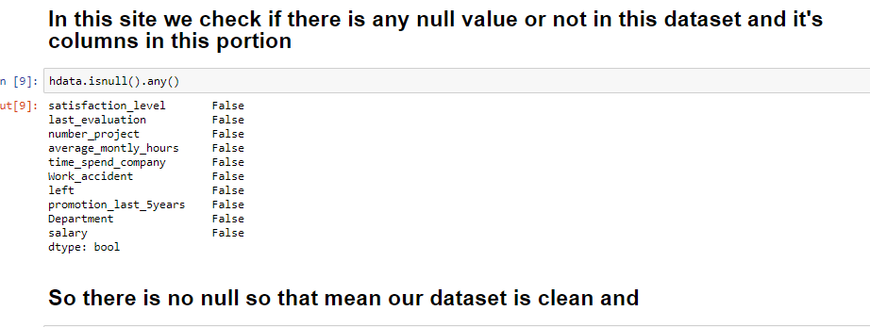
Using Is Null Function
We use is null is there are any null values in this dataset
So there is no null values so dataset is clean we can start operation

Slide 38
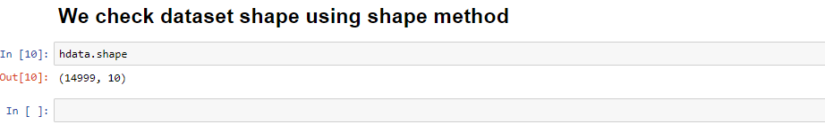
To check dataset shape
To check dataset shape we use shape() function
You can see There is 15000 rows and 10 columns in this dataset

Slide 39
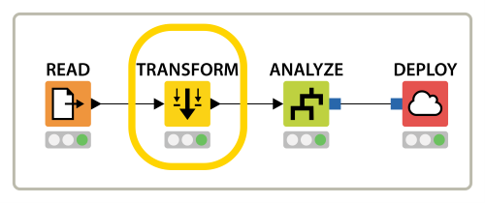
Data manipulation
Data manipulation is the process of changing data to make it easier to read or be more organized

Slide 40
Exploring the Dataset
We don’t know how much information in this dataset so that’s why we checking unique values for every columns to get Idea which columns we need to Explore

Slide 41
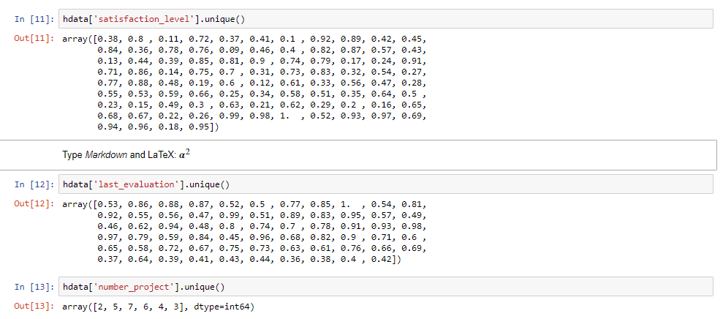
Exploring Unique Values for Every Columns
To see If there are some values we can add in Dataset Columns. We just check every unique Values

Slide 42
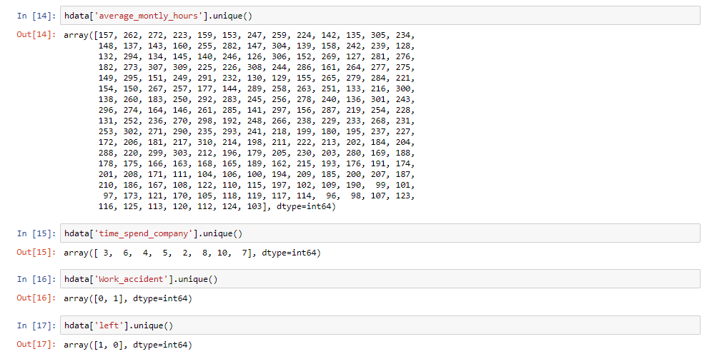
Exploring Unique Values for Every Columns

Slide 43
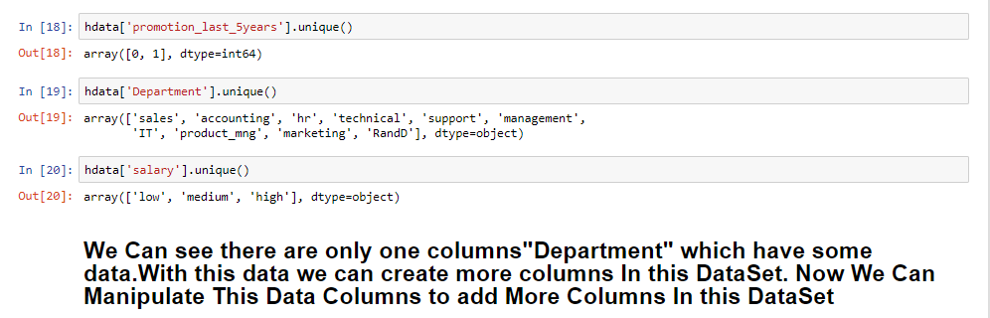
Exploring Unique Values for Every Columns
You can see there are only two columns that we can do operations and get some ideas

Slide 44
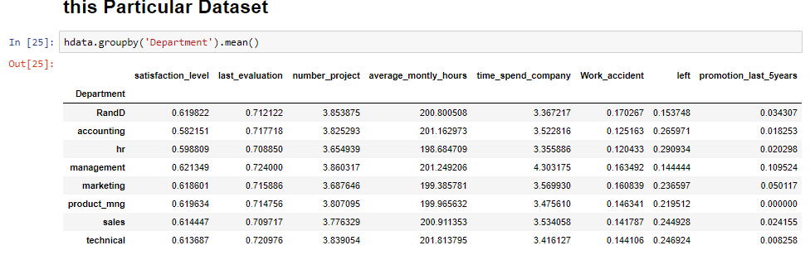
Check Department Mean Values
To check Department mean values we use mean() function

Slide 45
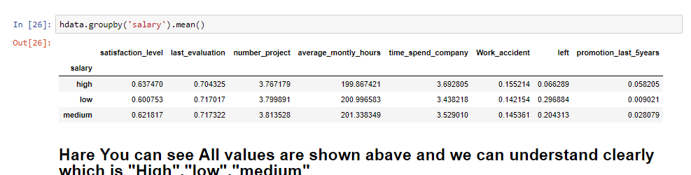
Checking Salary Mean Values
There are three Types of salary Which is low,high,mediam so the mean values is

Slide 46

Data Visualization
Data visualization is the graphical representation of information and data. By using visual elements like charts, graphs, and maps, data visualization tools provide an accessible way to see and understand trends, outliers, and patterns in data

Slide 47
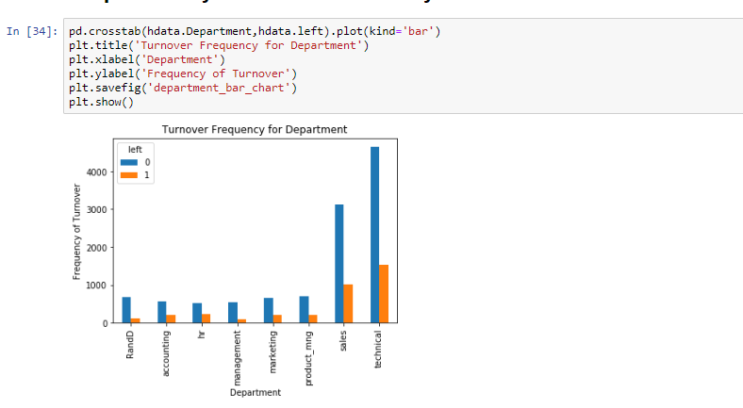
Using Data Visualization On this Project
Using Bar Plot We can see Each Of Department How much sell They done

Slide 48
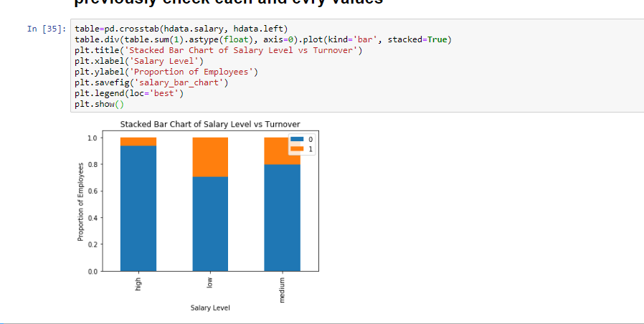
A bar plot of Proportion of Employees and Salaries

Slide 49
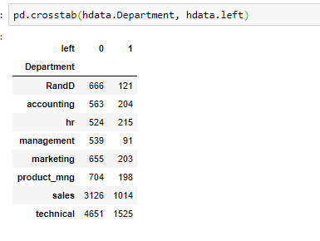
We Use crossTab on Department and Left Columns to compute Frequency

Slide 50
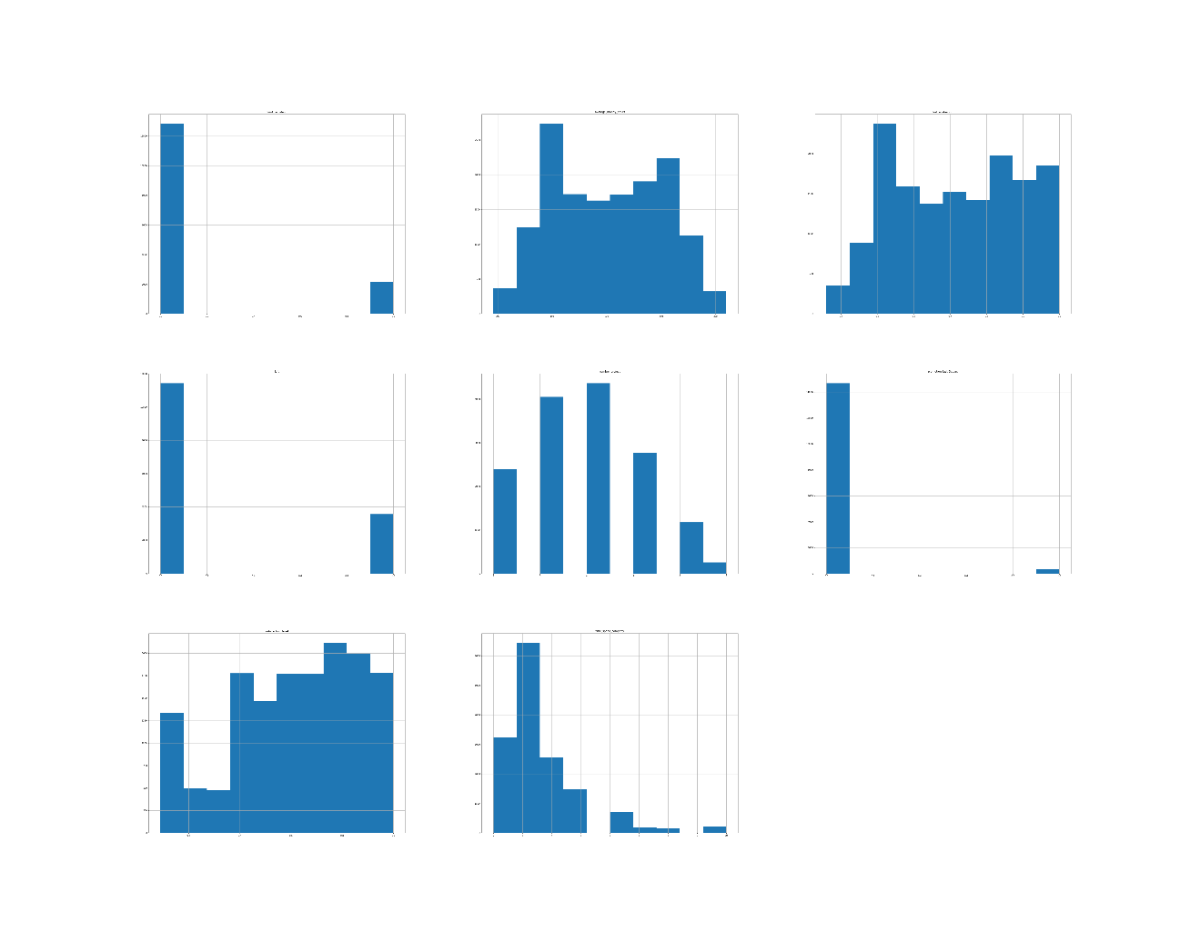
Creation Plot For each Department

Slide 51
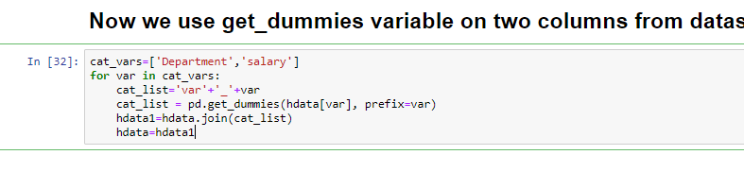
Create a Dummy Variables For Department and Sales columns

Slide 52
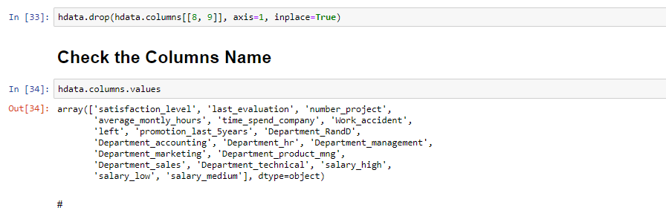
Therefore we Create a Dummy Variable for Department so we have to drop Department From Dataset

Slide 53
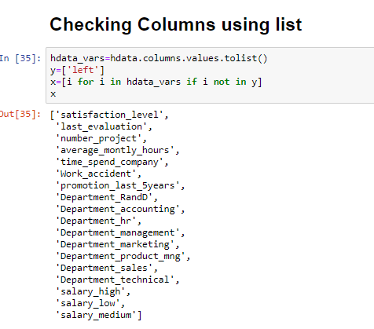
Check The Columns list After Drop The Column Department

Slide 54
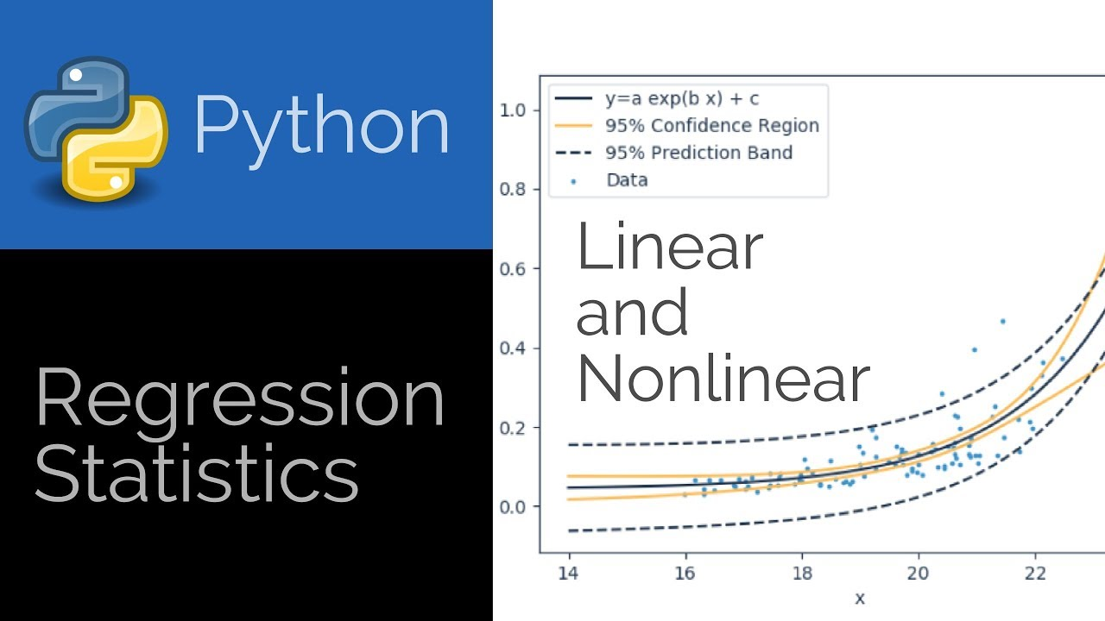
Apply Statistics On this Dataset
We have to predict some values on this Dataset so that mean we have to apply statistics on this project/dataset
Python is a general-purpose language with statistics modules

Slide 55
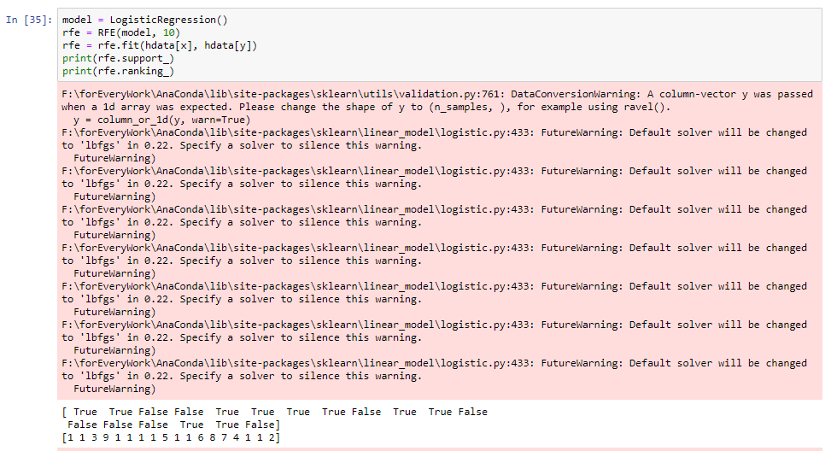
Apply sklearn_model and LogisticRegression

Slide 56
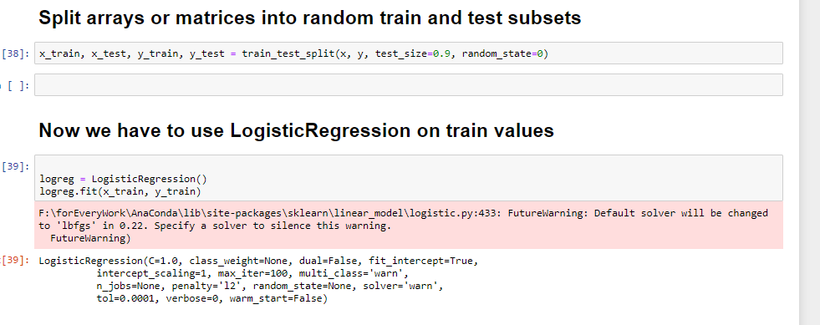
Using Split array to random train,test subset and LogisticRegression on Train Values

Slide 57
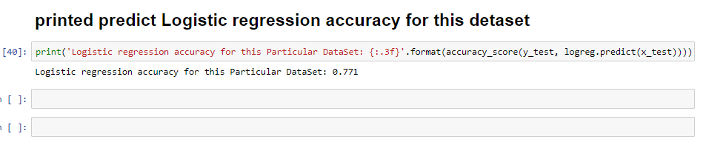
We Predict Logistic Regression Accuracy so it is
So the Logistic Regression Accuracy is 0.771

Slide 58
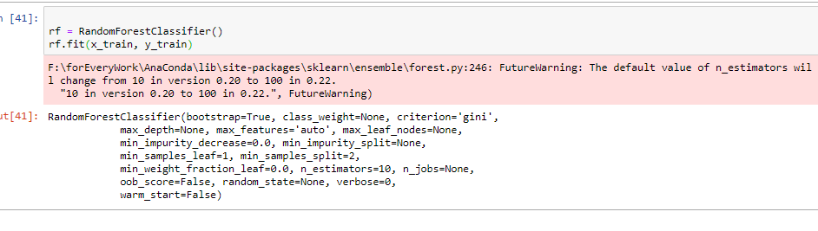
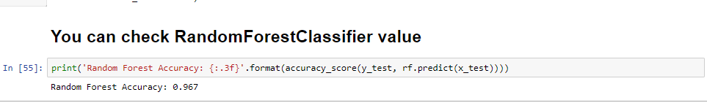
Apply RandomForestClassifier on Train values and It’s Accuricy

Slide 59
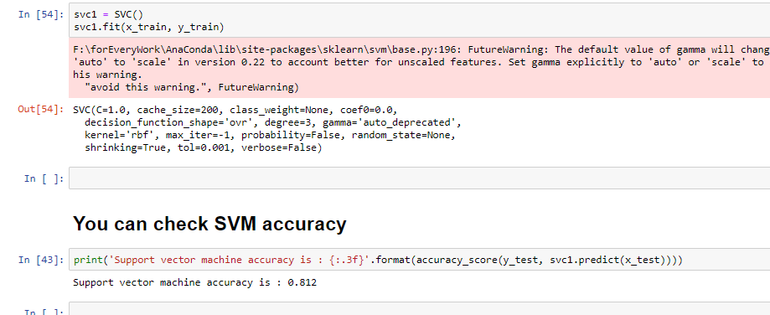
Apply Supported Vector Machine on train values and it’s accuricy

Slide 60
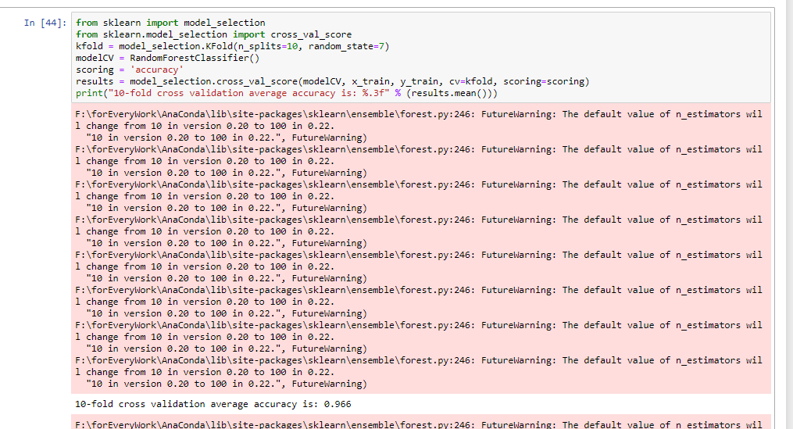
Checking 10-fold cross validation average accuracy

Slide 61
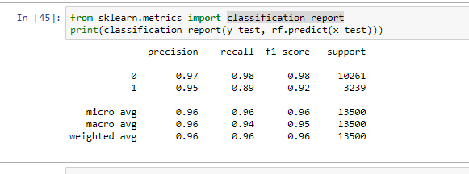
Get a classification Matrices report

Slide 62
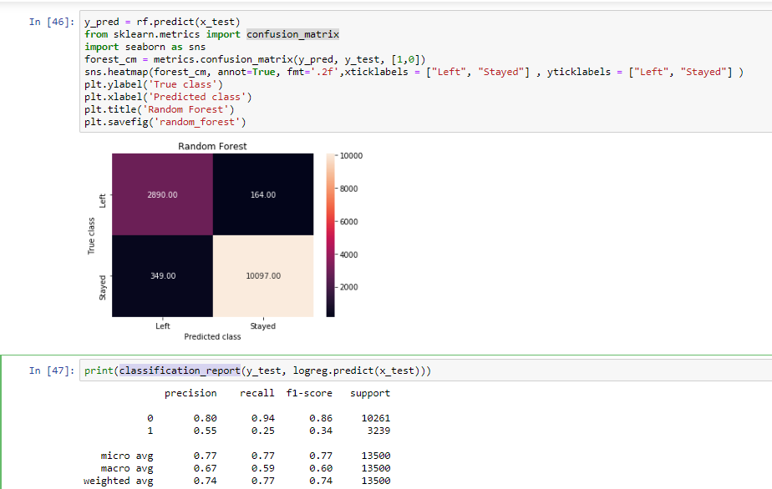
Get a confusion matrix and Apply classification report on test values

Slide 63
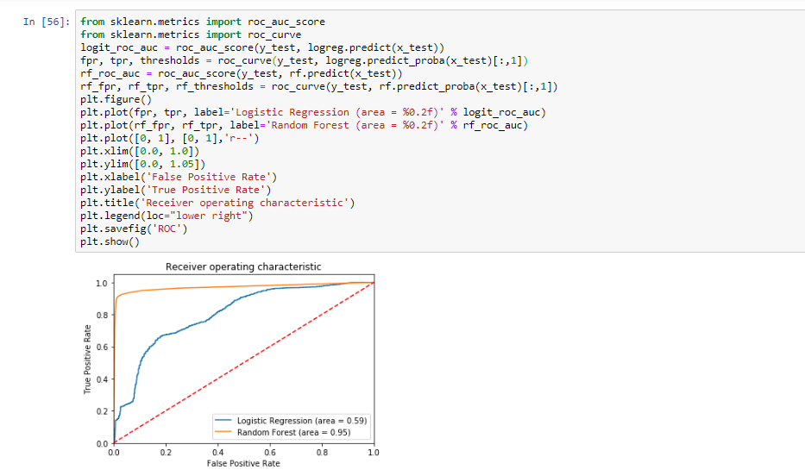
Create a Plot That show Random Forest and Logistic Regression Accuracy

Slide 64

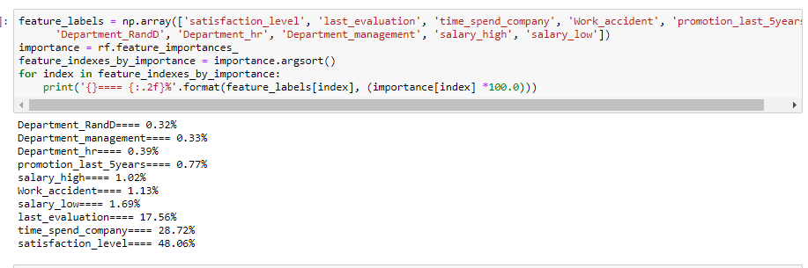
All Major Percentage level for this company

Slide 65

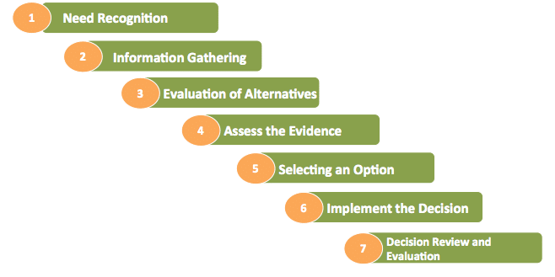
Decision making

Slide 66
Decision For this Particular Dataset
You can see for every employee don’t have much satisfaction level all are less then 50%
Company has less promotion percentage that are 0.77% in last 5 years
Mainly This two reason employee left the company no good facility is provide by the company

Slide 67

Conclusion
HR analytics is an essential part of data management and its implementation can yield positive returns for any organization. But as the above has shown, the management, analysis and interpretation of data isn't always straightforward and organizations need to approach HR analytics one step at a time

Slide 68
Thanks For Connect with us
Notes:
You can use this slide as your opening or closing slide. Should you choose to use it as a closing, make sure you review the main points of your presentation. One creative way to do that is by adding animations to the various graphics on a slide. This slide has 4 different graphics, and, when you view the slideshow, you will see that you can click to reveal the next graphic. Similarly, as you review the main topics in your presentation, you may want each point to show up when you are addressing that topic.
Add animation to images and graphics:
Select your image or graphic.
Click on the Animations tab.
Choose from the options. The animation for this slide is “Split”. The drop-down menu in the Animation section gives even more animations you can use.
If you have multiple graphics or images, you will see a number appear next to it that notes the order of the animations.
Note: You will want to choose the animations carefully. You do not want to make your audience dizzy from your presentation.

